Slide 1

DATA WAREHOUSE
Submitted To:- Mrs. Apurva Omer
Lecturer
Dept. Of Computer Science

Slide 2
What is Data warehouse?
Characteristics of Data warehouse
Subject-Oriented
Integrated
Time-Variant
Non-volatile
Data Warehouse Architectures

Slide 3
DATA WAREHOUSE
A data Warehouse is a relational database that is designed for query and analysis.
Data warehouse is an information system that contains historical and commutative data from single or multiple sources.
It is also a single version of truth for any company for decision making and forecasting.

Slide 4
CHARACTERSTICES OF DATA WAREHOUSE
DW
integrated
Subject oriented
Non-volatile
Time-varient

Slide 5
SUBJECT-ORIENTED
A data warehouse is subject oriented as it offers information regarding a theme instead of companies' ongoing operations. These subjects can be sales, marketing, distributions, etc.
A data warehouse never focuses on the ongoing operations. Instead, it put emphasis on modeling and analysis of data for decision making. It also provides a simple and concise view around the specific subject by excluding data which not helpful to support the decision process.

Slide 6
Integrated
In Data Warehouse, integration means the establishment of a common unit of measure for all similar data from the dissimilar database. The data also needs to be stored in the Datawarehouse in common and universally acceptable manner.
A data warehouse is developed by integrating data from varied sources like a mainframe, relational databases, flat files, etc. Moreover, it must keep consistent naming conventions, format, and coding.
This integration helps in effective analysis of data. Consistency in naming conventions, attribute measures, encoding structure etc. have to be ensured. Consider the following example:

Slide 7
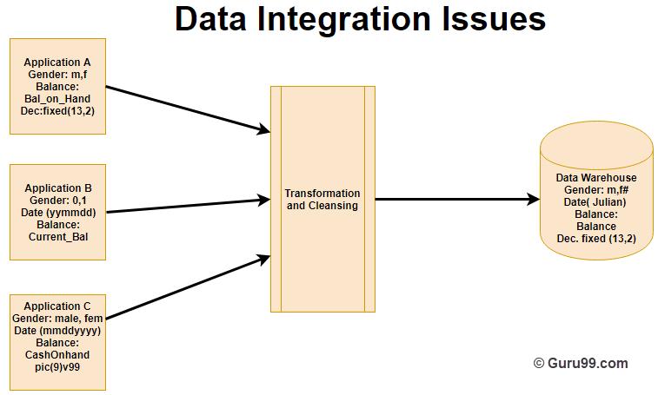

Slide 8
In the above example, there are three different application labeled A, B and C. Information stored in these applications are Gender, Date, and Balance. However, each application's data is stored different way.
In Application A gender field store logical values like M or F
In Application B gender field is a numerical value,
In Application C application, gender field stored in the form of a character value.
Same is the case with Date and balance
However, after transformation and cleaning process all this data is stored in common format in the Data Warehouse.

Slide 9
Time-Variant
The time horizon for data warehouse is quite extensive compared with operational systems. The data collected in a data warehouse is recognized with a particular period and offers information from the historical point of view. It contains an element of time, explicitly or implicitly.
One such place where Datawarehouse data display time variance is in in the structure of the record key. Every primary key contained with the DW should have either implicitly or explicitly an element of time. Like the day, week month, etc.
Another aspect of time variance is that once data is inserted in the warehouse, it can't be updated or changed.

Slide 10
Non-volatile
Data warehouse is also non-volatile means the previous data is not erased when new data is entered in it.
Data is read-only and periodically refreshed. This also helps to analyze historical data and understand what & when happened. It does not require transaction process, recovery and concurrency control mechanisms.
Activities like delete, update, and insert which are performed in an operational application environment are omitted in Data warehouse environment. Only two types of data operations performed in the Data Warehousing are
Data loading
Data access

Slide 11
Data Warehouse Architectures
There are mainly three types of Datawarehouse Architectures: -
Single-tier architecture
The objective of a single layer is to minimize the amount of data stored. This goal is to remove data redundancy. This architecture is not frequently used in practice.
Two-tier architecture
Two-layer architecture separates physically available sources and data warehouse. This architecture is not expandable and also not supporting a large number of end-users. It also has connectivity problems because of network limitations.
Three-tier architecture
This is the most widely used architecture.
It consists of the Top, Middle and Bottom Tier.
Bottom Tier: The database of the Datawarehouse servers as the bottom tier. It is usually a relational database system. Data is cleansed, transformed, and loaded into this layer using back-end tools.
Middle Tier: The middle tier in Data warehouse is an OLAP server which is implemented using either ROLAP or MOLAP model. For a user, this application tier presents an abstracted view of the database. This layer also acts as a mediator between the end-user and the database.
Top-Tier: The top tier is a front-end client layer. Top tier is the tools and API that you connect and get data out from the data warehouse. It could be Query tools, reporting tools, managed query tools, Analysis tools and Data mining tools.

Slide 12
Data warehouse is an information system that contains historical and commutative data from single or multiple sources.
A data warehouse is subject oriented as it offers information regarding subject instead of organization's ongoing operations.
In Data Warehouse, integration means the establishment of a common unit of measure for all similar data from the different databases
Data warehouse is also non-volatile means the previous data is not erased when new data is entered in it.
A Datawarehouse is Time-variant as the data in a DW has high shelf life.
There are 5 main components of a Datawarehouse. 1) Database 2) ETL Tools 3) Meta Data 4) Query Tools 5) DataMarts
These are four main categories of query tools 1. Query and reporting, tools 2. Application Development tools, 3. Data mining tools 4. OLAP tools
The data sourcing, transformation, and migration tools are used for performing all the conversions and summarizations.
In the Data Warehouse Architecture, meta-data plays an important role as it specifies the source, usage, values, and features of data warehouse data.

